Slide 1

Blockchain Project
106117013
Ashutosh Kushwaha

Slide 2

Idea?

Slide 3
KICKSTARTER
Let’s imagine for a second you are the inventor and you come with some brand new products that you want to create. So you need money for employees, materials manufacturing and whatever else.
The idea of the Kickstarter is to help you to raise that money to build some initial prototypes of your project. So you come to Kickstarter as the product owner and you create a new product. You put your idea and discuss what you want to build and then you also ask random people on the internet for some money.
So, people donate money to your campaign, and in exchange, at some point in the future, you will give that person some reward.

Slide 4
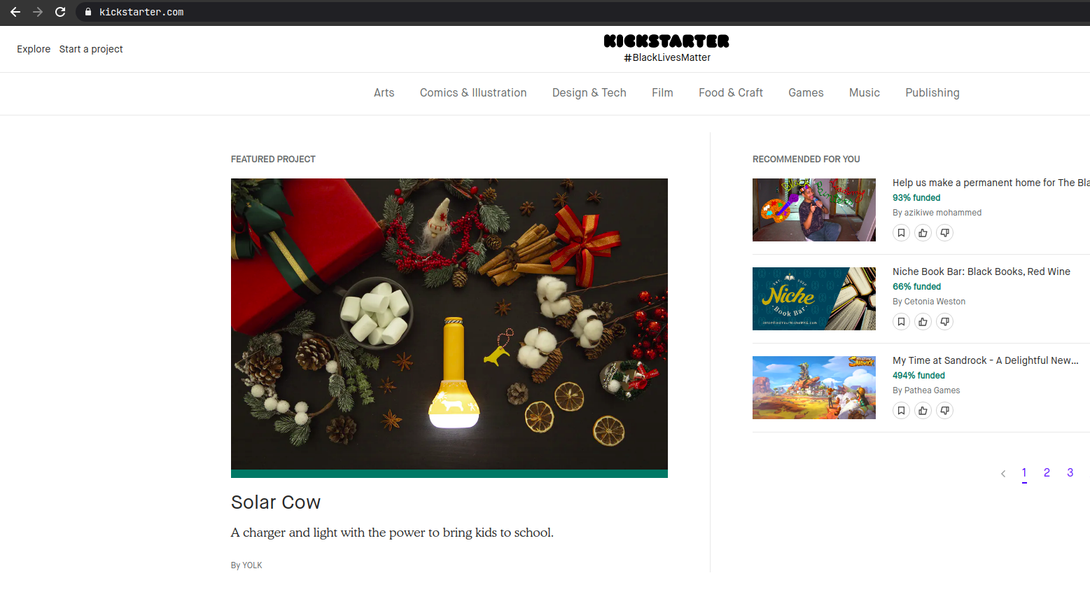
KICKSTARTER
Kickstarter is one of a number of crowdfunding platforms for gathering money from the public, which circumvents traditional avenues of investment.

Slide 5
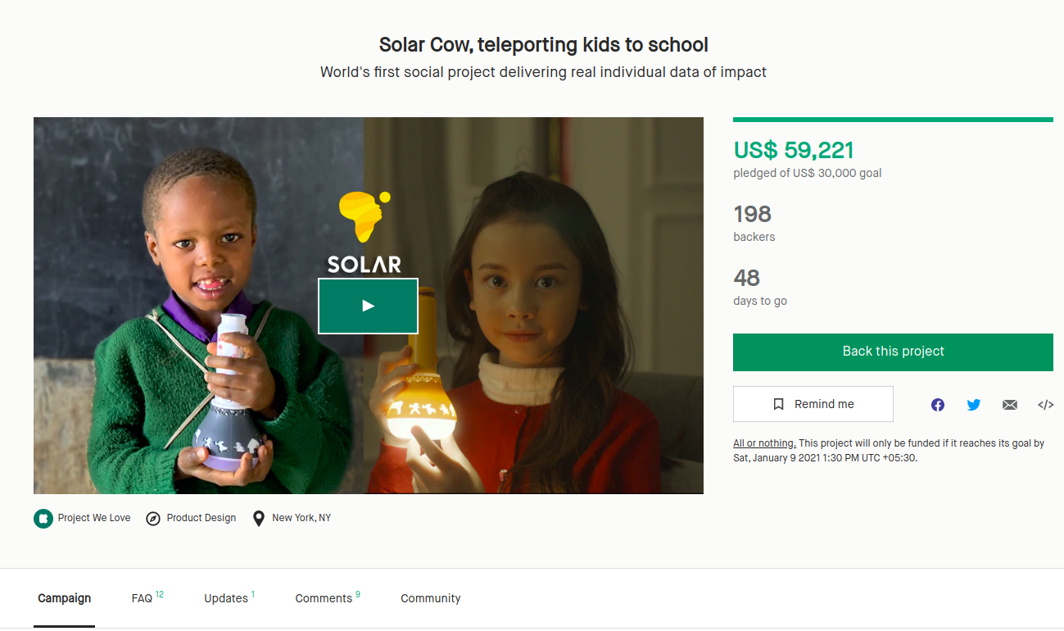
KICKSTARTER
Select a project according to your wish, anyone can create a campaign
And donate to the campaign.
Every campaign need some minimum requirement of pledged, once this Criteria completed, kickstarter collect all the money and send to the campaign creator.

Slide 6

Problem?

Slide 7
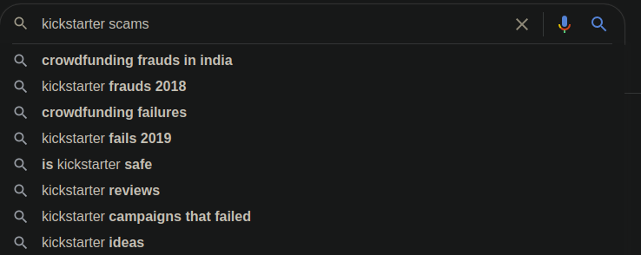
Problem
A simple google search on kickstarter scams
Ex. A autocompletion of google search engine shows how kickstarter bigger the problem is.

Slide 8
Problem
The problem is that some people who create campaigns are a little bit greedy.
It totally up to campaign creators to use the money that they get donated but they use this money on other projects rather than those products that can send to the donators and when they take the big bucket of money because there is no ability to actually manage a product so they say we lose the money and we have no money so all the investors lose their money. In the end, Scammers took all the money and ran away.

Slide 9

Solution?

Slide 10
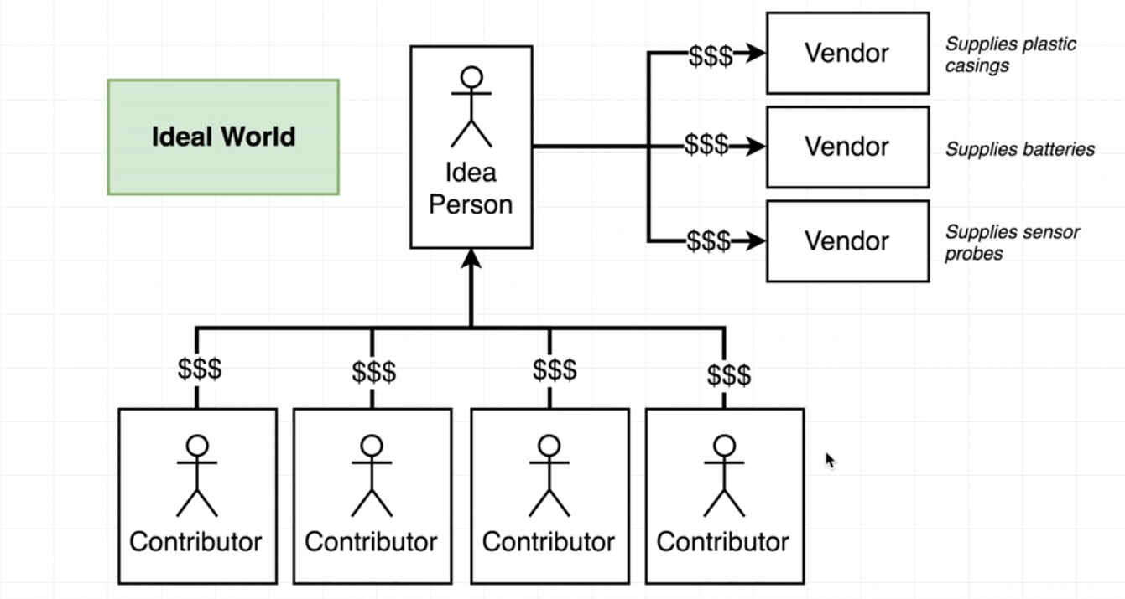
In Ideal World
Considering no one is malicious

Slide 11
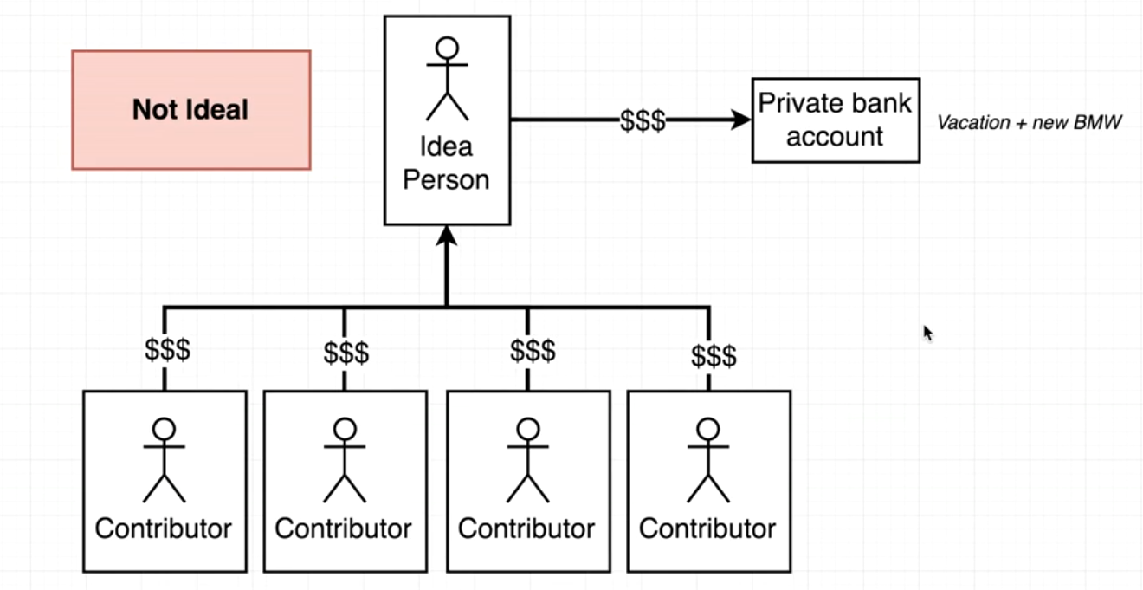
In Real World
Actually what happens(In most of cases, or what can be happens)

Slide 12

How Blockchain can help?

Slide 13
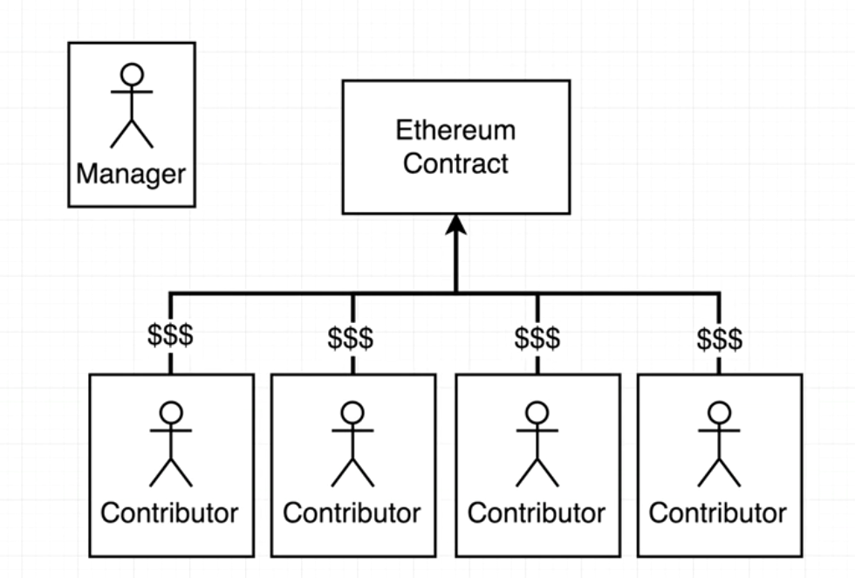
How Contributor contribute?
Here contributor don't directly pay to the Manager, instead they will pay the the Ethereum Contract.

Slide 14
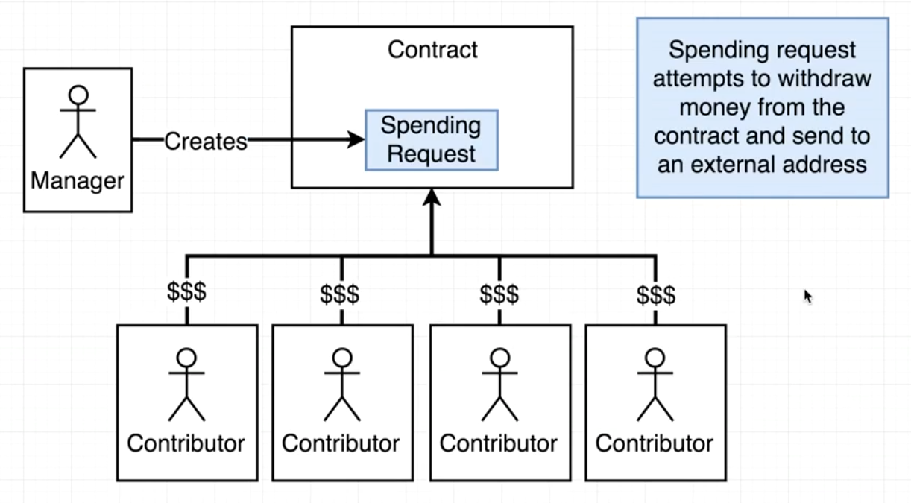
How Manager can request Money?
In the order of withdrawal, the manager need to make a spending request in the contract and send to the external address(vendor).

Slide 15
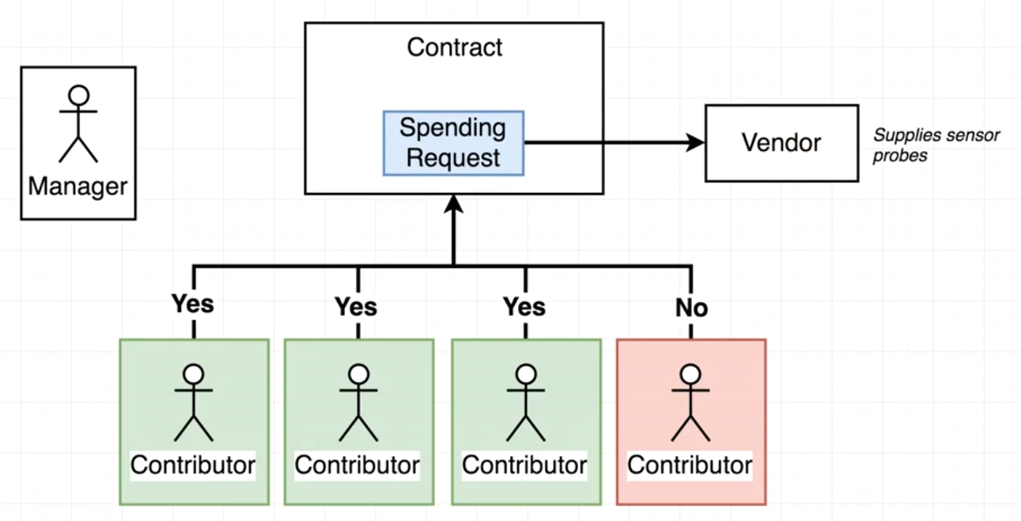
How Spending Request Works?
Whenever a Manager try to withdraw money from the Contract, Then every Contributor have to vote for every request.If enough people approve the spending request then only the Manager is allow to spend money outside the contract(external vendor).

Slide 16

Design

Slide 17
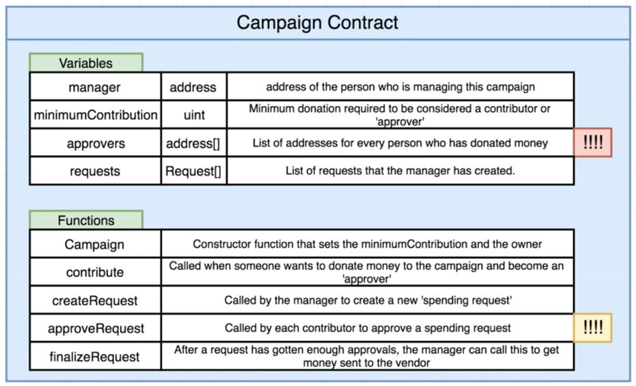
Design of Contract

Slide 18
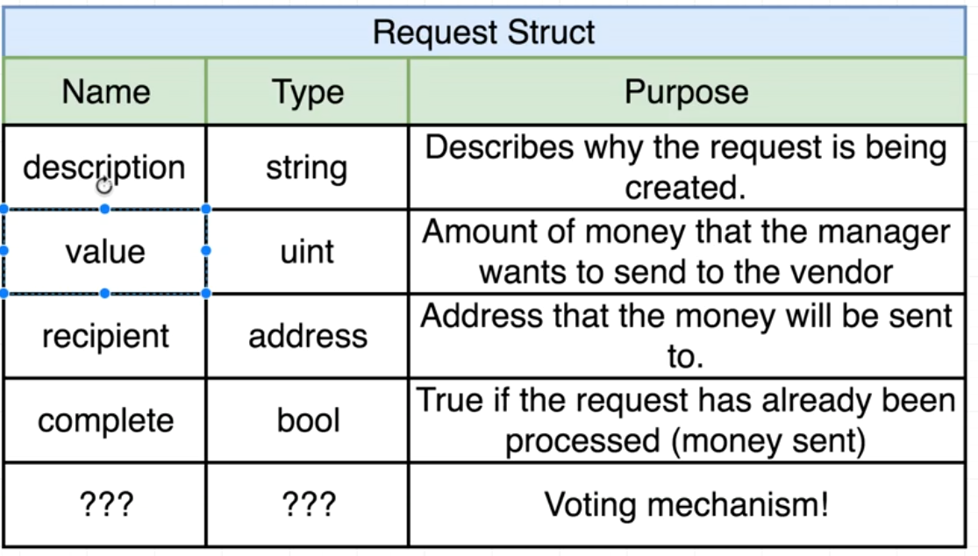
Design of Request struct

Slide 19

Move to VS CODE

